Slide 1
scara Robots
PDE4431 Industrial Manipulators
Judhi Prasetyo & Bittu Scaria
Middlesex University Dubai

Slide 2
SCARA Robots
The SCARA configuration provides different attributes to the articulated arm. This configuration was originally developed for assembly applications, hence the name Selective Compliance Assembly Robot Arm. The four-axis arm includes a base rotation, a linear vertical motion followed by two rotary motions in the same vertical plane.

Slide 3
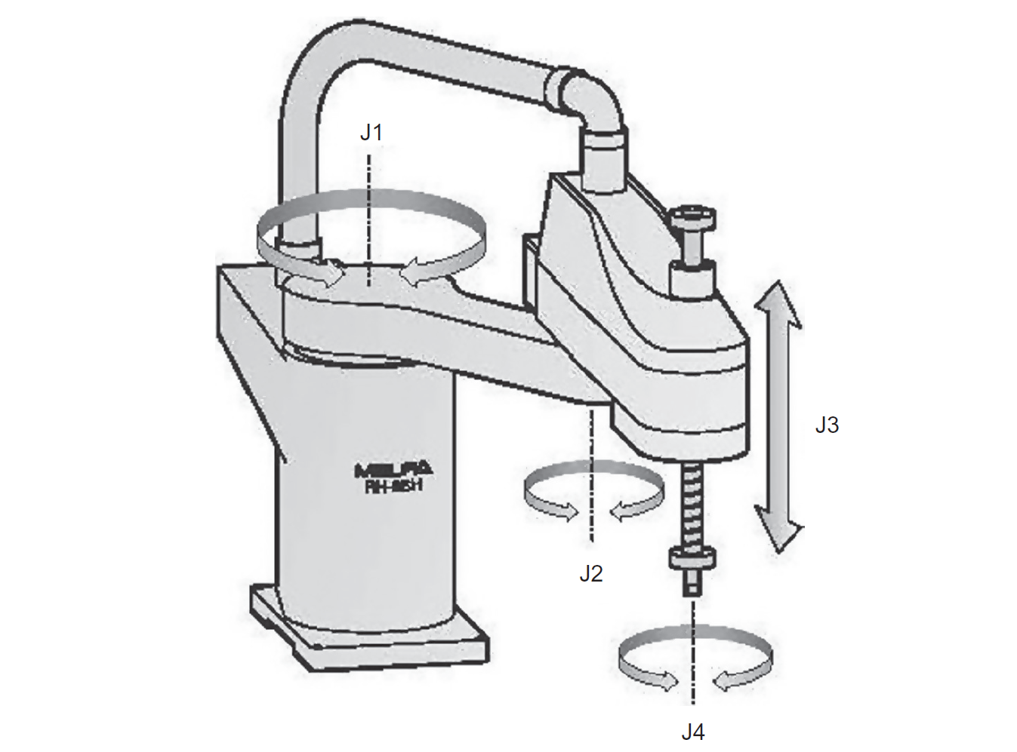
SCARA Configuration

Slide 4
Features of SCARA Robots
Due to the nature of the configuration the arm is very rigid in the vertical direction
It provides compliance in the horizontal plane.
It provides high speed combined with high acceleration.
Works to very tight tolerances.
SCARA machines are typically small with the largest having carrying capacities of about 2 kg and a reach of about 1 m.

Slide 5
Application
They are mainly used for assembly applications although they can also be used for packing, small press tending, adhesive dispensing, and other applications. The application of SCARAs is mainly constrained by their size and the limitation of being only four axes.

Slide 6
Cycle Time
A standard cycle time test for robots has been defined to provide comparability between machines. This so-called goalpost test consists of a 25 mm vertical move upward, followed by a 300 mm horizontal move, and a 25 mm vertical move down and simulates a typical move for an assembly application. The timings for SCARA robots to achieve this move, both forward and return, can be as low as 0.3 s. This is normally faster than the equivalent articulated arm, six-axis robots

Slide 7
SCARA Robot Population
The SCARA configuration makes up about 12% of global sales although it is more popular in Asia, due to the size of the electronics sector in this region. Asia accounts for about 50% of all SCARA robot sales.

Slide 8
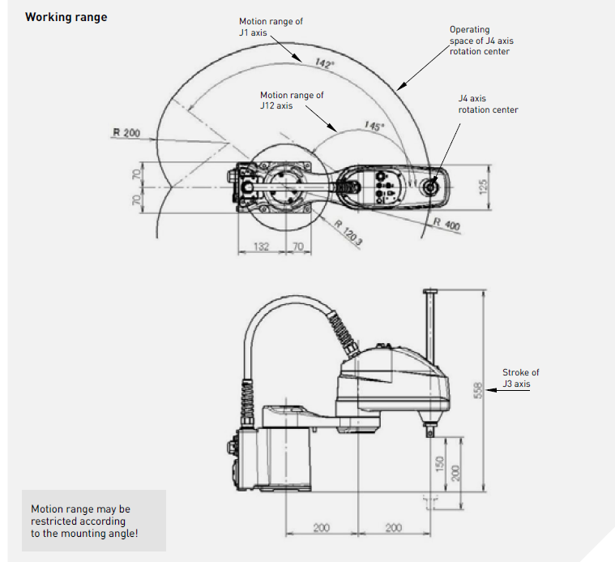
Working Range

